Slide 1
How to Search Internship
Resources During College
Arya, Cindy, Emily

Slide 2
PART 01
01
Abstract & Introduction

Slide 3
It is very important for college students to know how to find internship resources.
·provide students with practical experience
·build professional connections and relationships
·help people stand out from the competition
This article will explain how to find internship resources with detailed examples from both on-campus and off-campus resources.

Slide 4
PART 02
02
Using on-campus resources

Slide 5
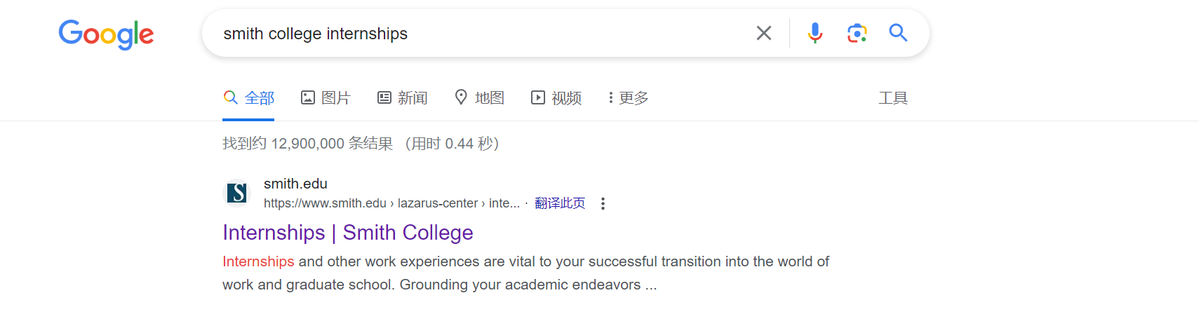
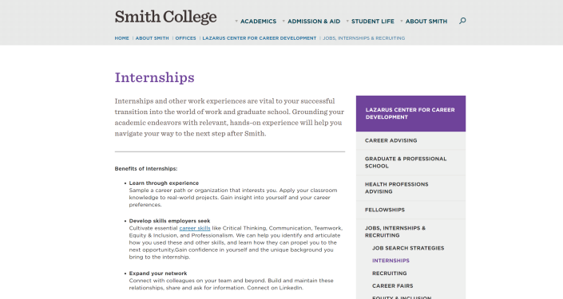

Slide 7

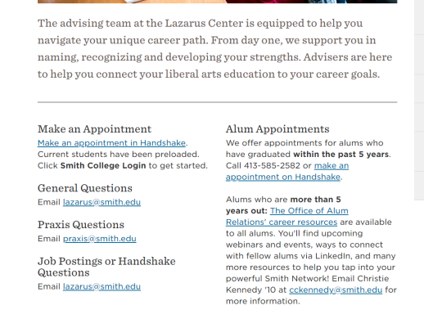

Slide 8

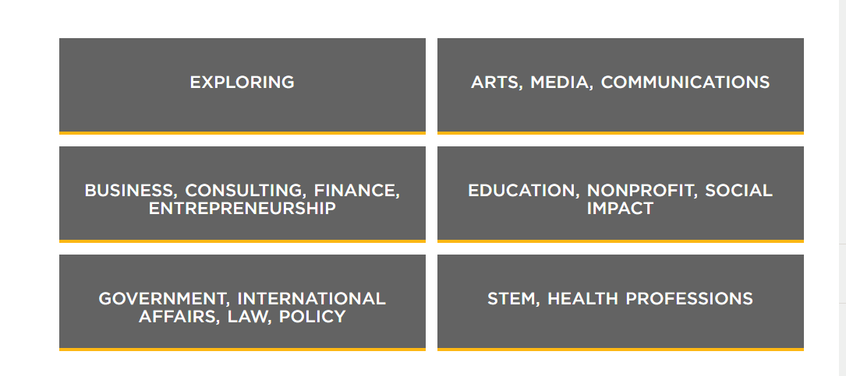

Slide 9

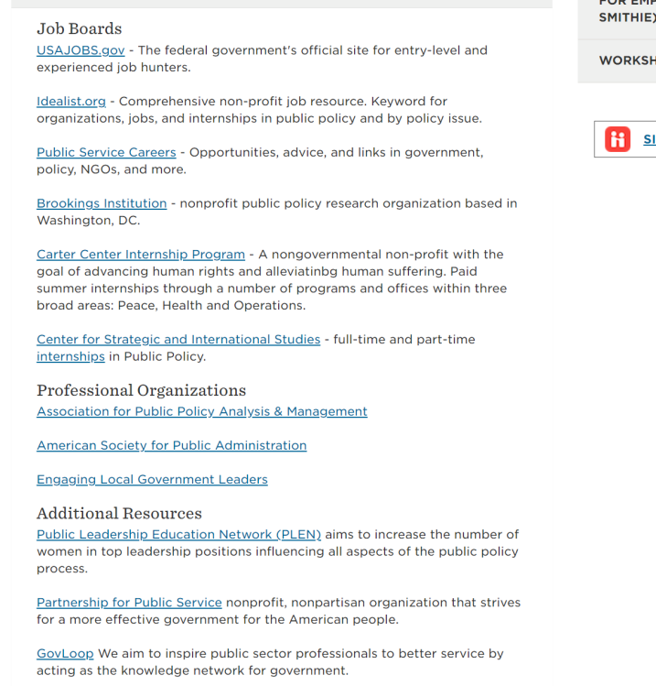

Slide 10
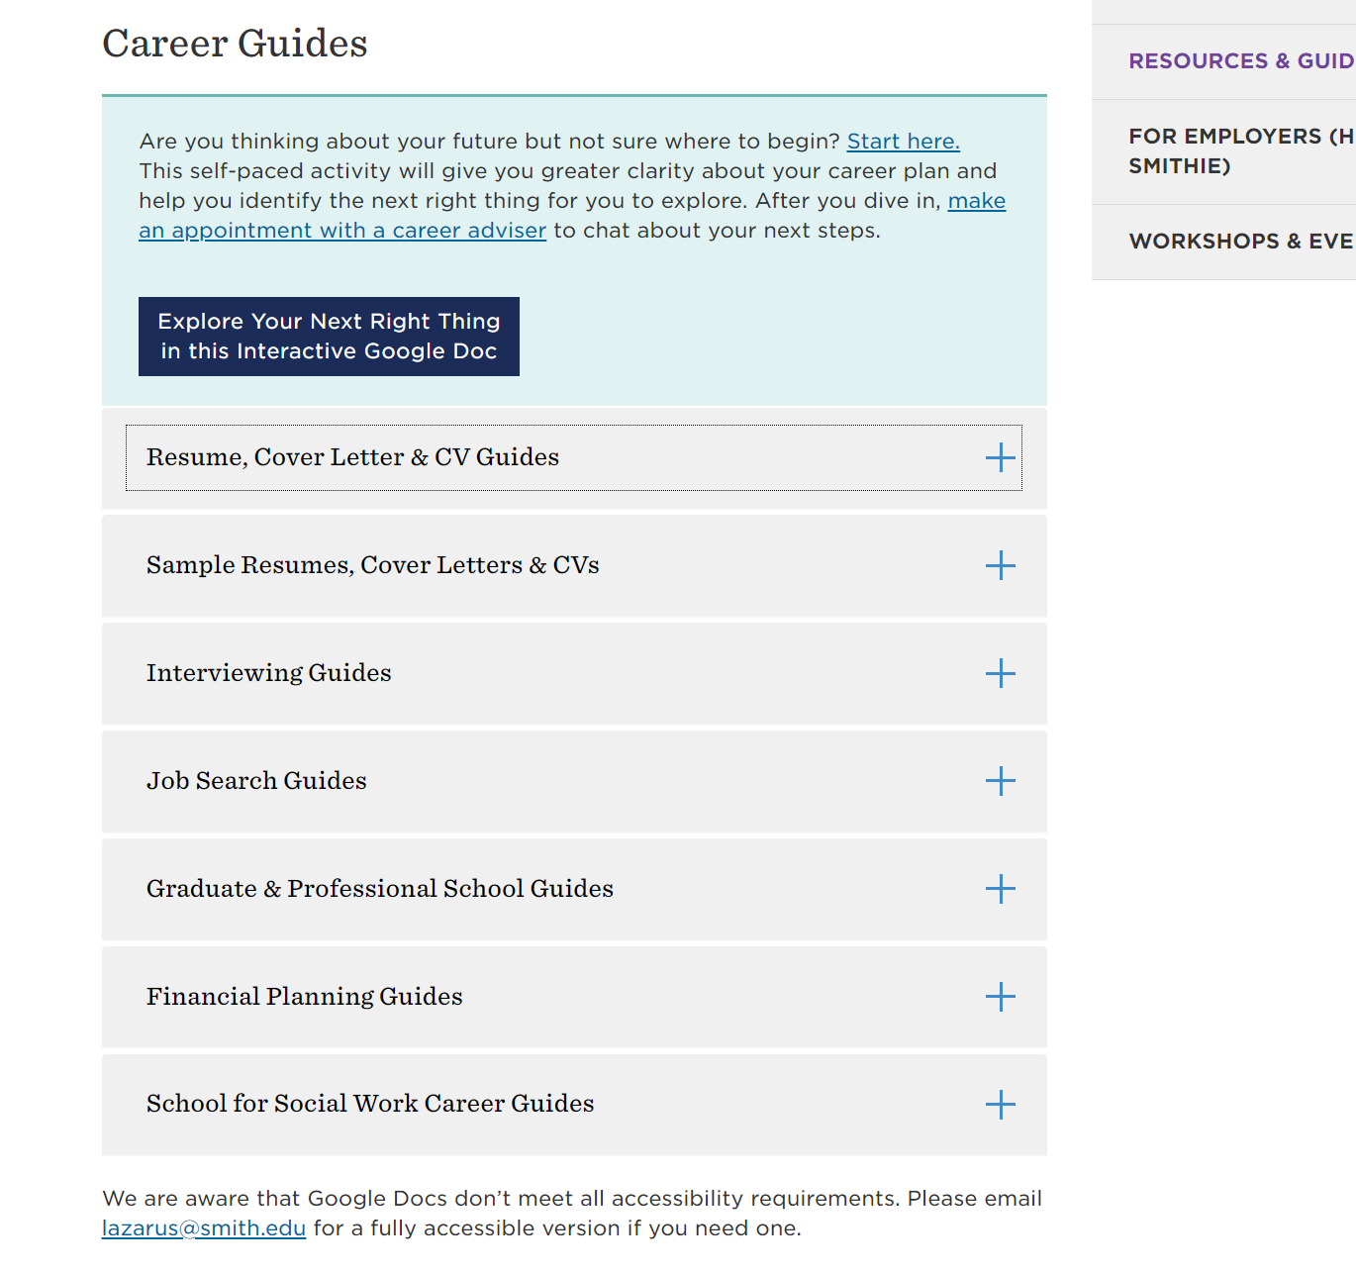
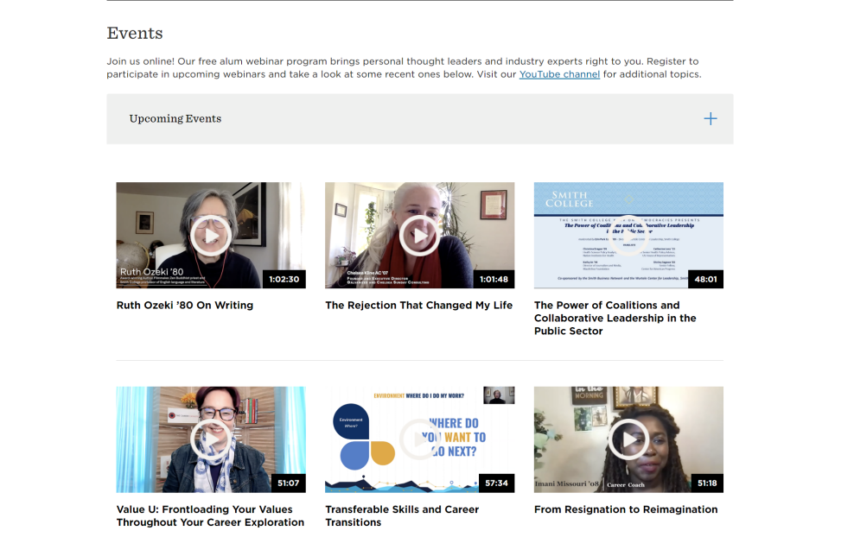

Slide 11
In general, there are four steps to fully grasp internship resources:
timely learn about the career advising center within the school and make an appointment with a teacher;
learn about the related career of one’s major on the official website of the school;
make preliminary contact with the company;
and establish a relationship with alumni.

Slide 12
PART 03
03
External resources

Slide 13
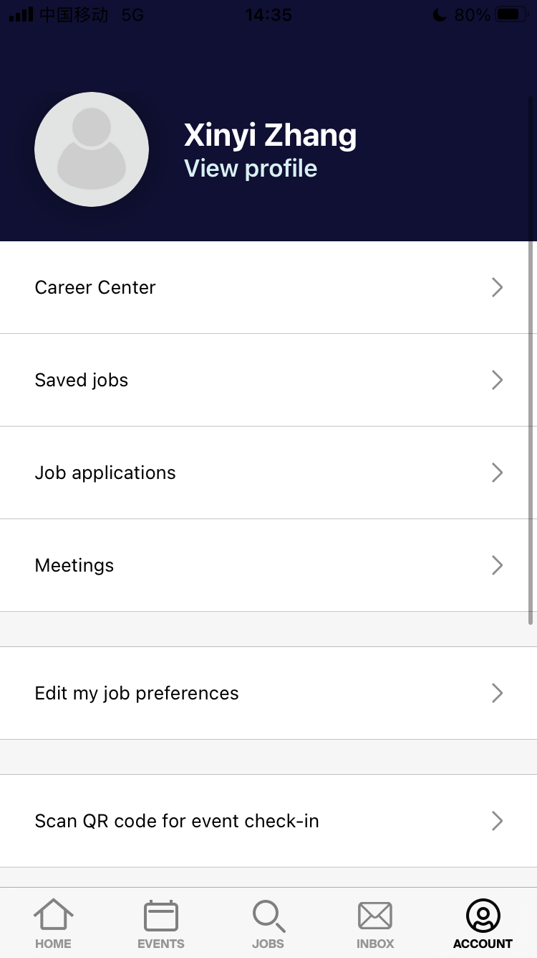
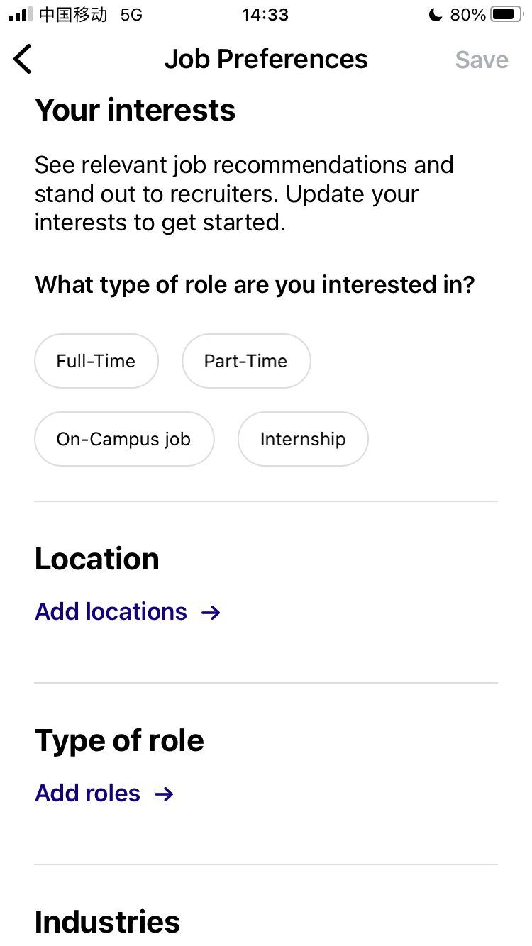

Slide 14
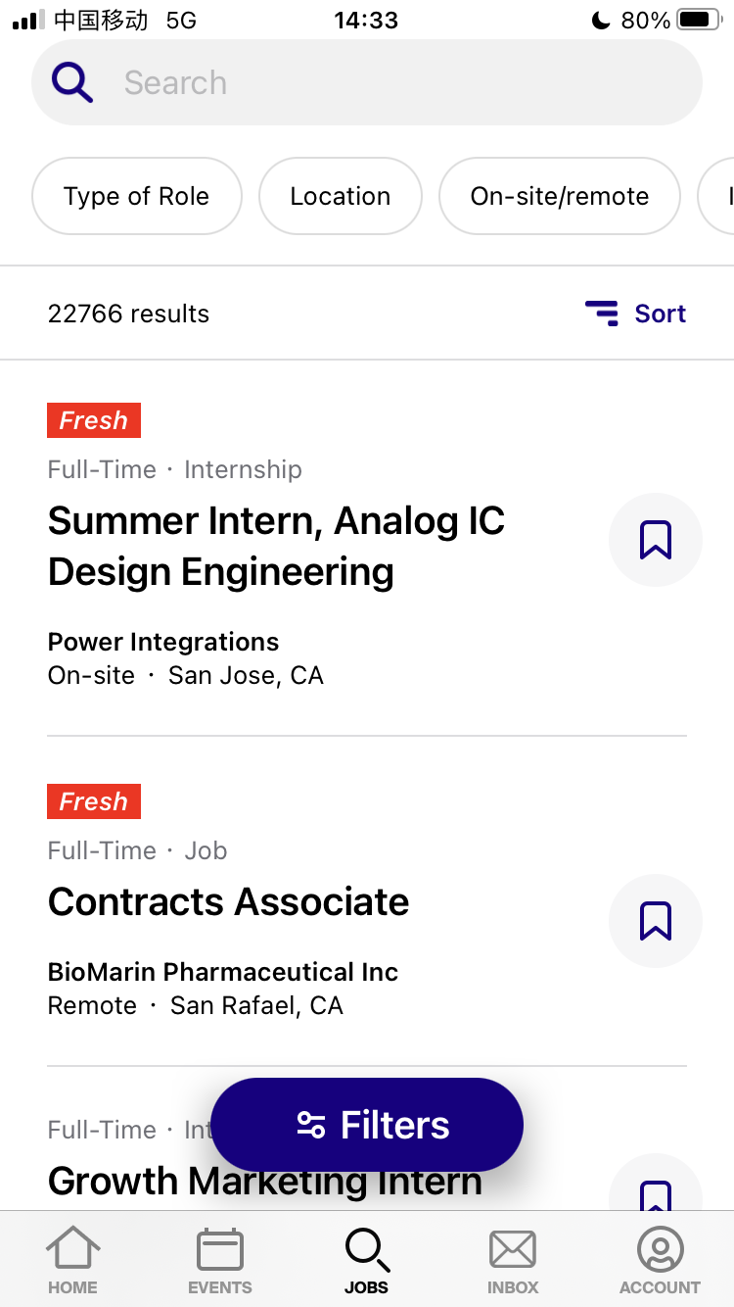
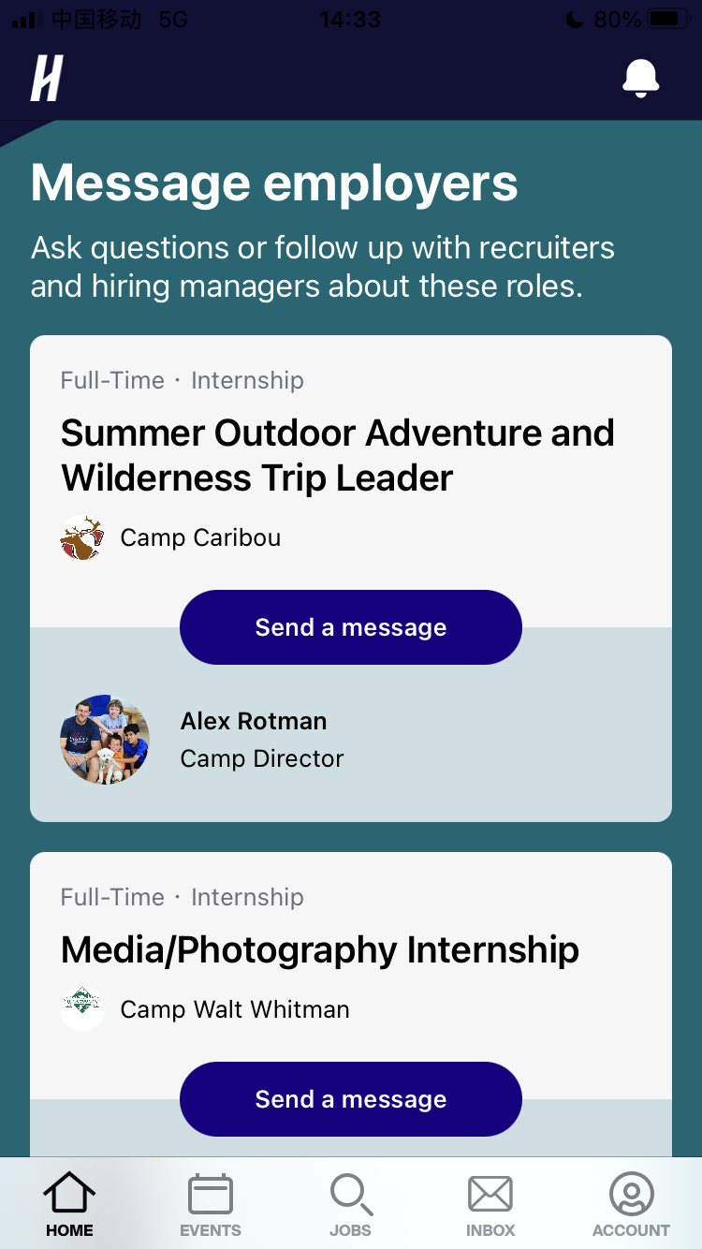

Slide 15
Thanks for
Listening

